Slide 1

Unleashing the Power of Agents
An Autogen Demo on Data Retrieval and Processing
Patrick Major is a Senior Developer with WorkSafeBC’s Advanced Technologies Solutions team, specializing in the design and implementation of intelligent agentic systems to solve complex challenges. With over 35 years of experience in IT and software development, his career includes pivotal roles at Electronic Arts Canada and Manulife Financial in addition to WorkSafeBC.
Reach me at: patrick_major@outlook.com
patrick.major@worksafebc.com
Source code: https://github.com/pmajor74/demo.autogen_meal_blogwriter

Slide 2
Presentation Agenda
1
What are Agents?
2
Autogen 0.4 Introduction
3
Why Autogen?
Understand the core concept of AI agents and their role in automation.
Explore Microsoft's Autogen framework and its features. Link: Autogen Docs
Discover the benefits of using Autogen for building collaborative AI agents.
4
Competing Frameworks
5
Agent Patterns
6
Demo and Q&A
Brief overview of alternative agentic frameworks.
Useful agent design patterns.

Slide 3
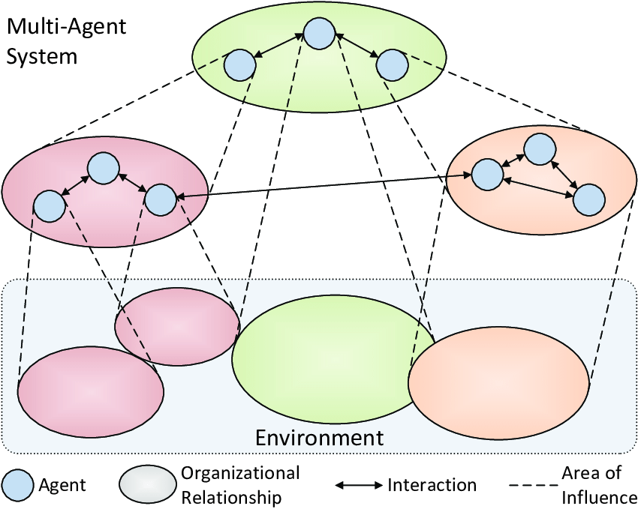
Understanding AI Agents
What Are Agents
What is a Multi-Agent System?
An agent is a software entity that communicates via messages, maintains its own state, and performs actions in response to received messages or changes in its state. These actions may modify the agent’s state and produce external effects, such as updating message logs, sending new messages, executing code, or making API calls.
Systems, composed of multiple interacting agents, are referred to as multi-agent applications.

Slide 4
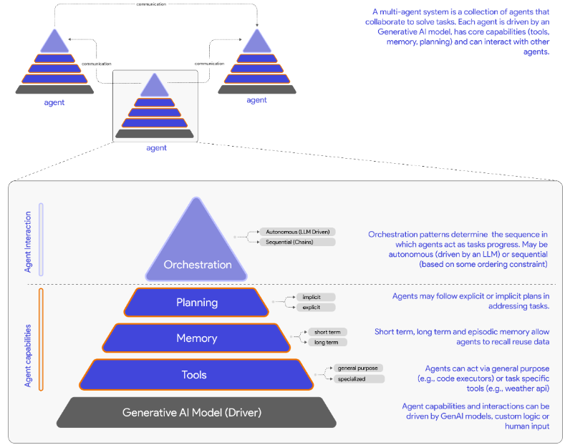
Components of a Multi-Agent System
Diagram excerpt from the book: Multi-Agent Systems with AutoGen by Victor Dibia, well worth the read.
Notes:
What is a multi-agent system? A group of autonomous LLM agents given a set of tools, pattern of communication and directives that can work together to achieve given tasks.
Each agent is a self-contained unit that can be developed, tested, and deployed independently.
This modular design allows agents to be reused across different scenarios and composed into more complex systems.
Agents are inherently composable: simple agents can be combined to form complex, adaptable applications, where each agent contributes a specific function or service to the overall system.
Explicit Planning: This refers to a structured, predefined approach where the sequence of actions is clearly outlined in advance. Think of it as a detailed roadmap or a step-by-step recipe that agents follow. For example, in a multi-agent system tasked with writing a report, an explicit plan might specify that Agent A gathers data, Agent B analyzes it, Agent C drafts the report, and Agent D edits it—all in that exact order. This plan could be driven by a large language model (LLM) or predefined logic, ensuring each agent knows precisely what to do and when. It’s rigid and predictable, ideal for tasks where clarity and consistency are key.
Implicit Planning: In contrast, implicit planning is more flexible and adaptive. There’s no fixed sequence laid out ahead of time; instead, agents decide their actions dynamically based on the current context, available data, or real-time reasoning. Using the same report-writing example, agents might assess the draft’s progress and adjust on the fly—say, sending an agent to gather more data if the analysis reveals gaps, without adhering to a strict order. This approach allows agents to respond to changing conditions, making it suited for tasks that require adaptability over structure.

Slide 5

What is Autogen (0.4)?
An open-source framework designed by Microsoft Research’s AI Frontiers Lab to build AI agent systems.
It simplifies the creation and orchestration of event-driven, distributed agentic applications
AutoGen supports scenarios where multiple agents interact with each other to complete complex tasks autonomously or with human oversight.
Autogen 0.4 framework: https://microsoft.github.io/autogen/stable/
Notes:
Overview: AutoGen 0.4, from Microsoft Research’s AI Frontiers Lab, is an open-source framework for building AI agent systems. It’s designed for event-driven, distributed workflows where agents collaborate autonomously over time, with optional human oversight.
Core Architecture: Built on a pub/sub model for communication and the actor model for distributed computation, AutoGen’s core enables agents to act independently—making decisions, creating new agents, and sending messages without locks—perfect for long-running tasks across systems.
Agent Capabilities: Agents leverage a layered structure: Tools for task execution, Memory for retaining data, Planning for task strategies, and Orchestration for coordination. This supports seamless collaboration on complex, multi-step workflows.
Scalability & Flexibility: The distributed design scales easily by adding agents, while support for C# and Python offers developers flexibility to build tailored agentic applications.

Slide 6

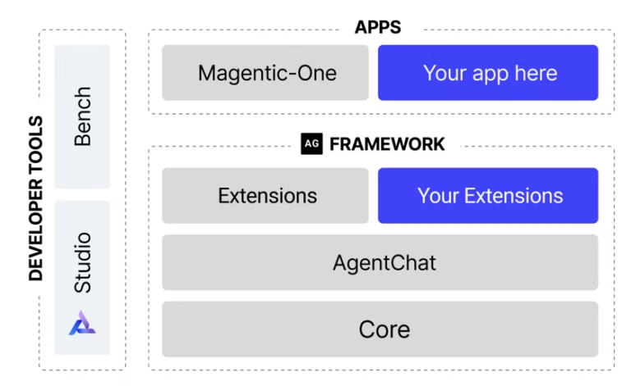
Why Autogen?
The AutoGen ecosystem provides everything you need to create AI agents, especially multi-agent workflows -- framework, developer tools, and applications.
Open-Source AI Powerhouse
Craft flexible agent systems with ease
Event-Driven & Scalable
Build distributed workflows that adapt
Modular & Cross-Language
Customize in Python or .NET
Community-Driven Growth
Extend with built-in and user tools
Notes:
1. Open-Source AI Powerhouse
AutoGen 0.4 is an open-source framework designed to make building AI agent systems straightforward and powerful. It’s all about flexibility—whether you’re creating a single agent or a team of them, AutoGen provides the tools to simplify the process. With its layered architecture, you can work at the level of abstraction that fits your needs, from high-level APIs to low-level components, ensuring you have full control over your system’s design.
2. Event-Driven & Scalable
One of AutoGen’s standout features is its asynchronous messaging. Agents communicate through messages that support both event-driven and request/response patterns, making workflows responsive and adaptable to real-time changes. It’s also scalable and distributed, so you can design complex agent networks that operate seamlessly across organizational boundaries—perfect for tackling big, distributed challenges.
3. Modular & Cross-Language
AutoGen is built to be modular and extensible. You can easily customize your systems with pluggable components like custom agents, tools, memory, and models, even creating proactive, long-running agents for dynamic tasks. Plus, it offers cross-language support, letting you develop in Python or .NET. This interoperability means your agents can work together, no matter the language they’re built in, broadening your development options.
4. Community-Driven Growth
AutoGen comes with built-in and community extensions, so you’re not starting from scratch—you can leverage existing tools or tap into innovations from open-source developers. It also includes observability and debugging features, with built-in tools for tracking, tracing, and debugging workflows, supported by OpenTelemetry. And with full type support, the framework enforces interfaces and extensive typing, ensuring consistent, high-quality code and reliable APIs you can depend on.

Slide 7
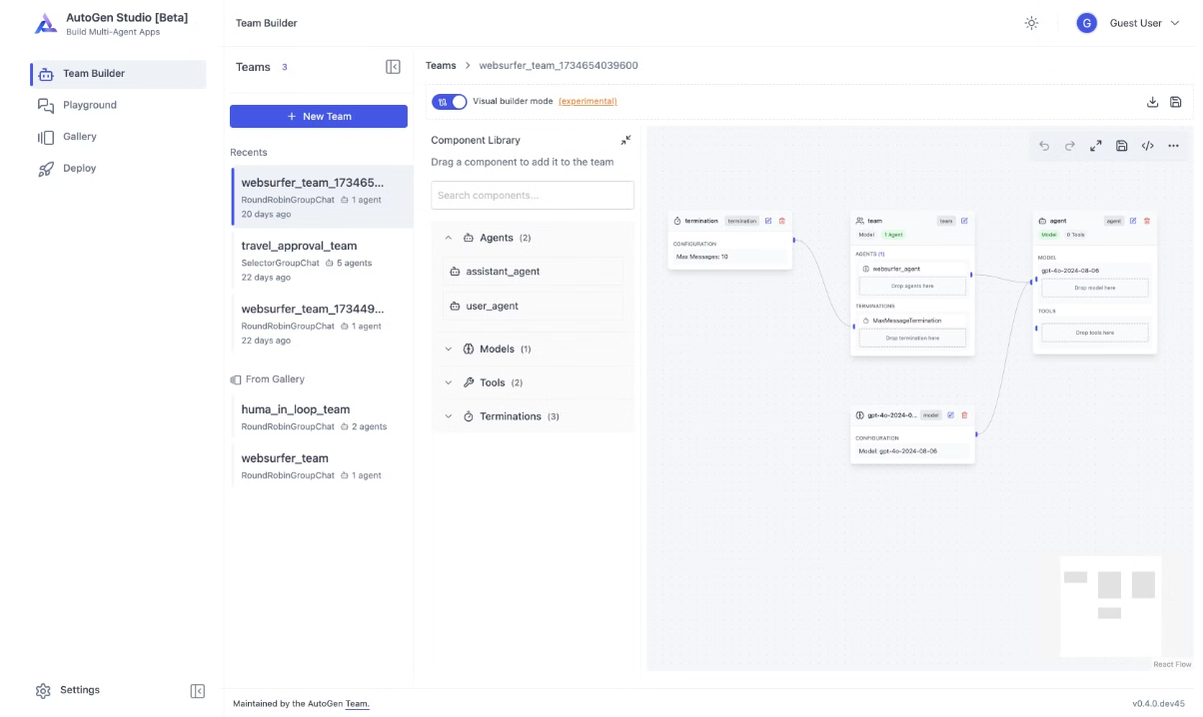
The Autogen ecosystem also supports two essential developer tools:
AutoGen Studio provides a no-code GUI for building multi-agent applications.
AutoGen Bench provides a benchmarking suite for evaluating agent performance. – note this works only for Autogen 0.2, but work is currently being updated for 0.4

Slide 8
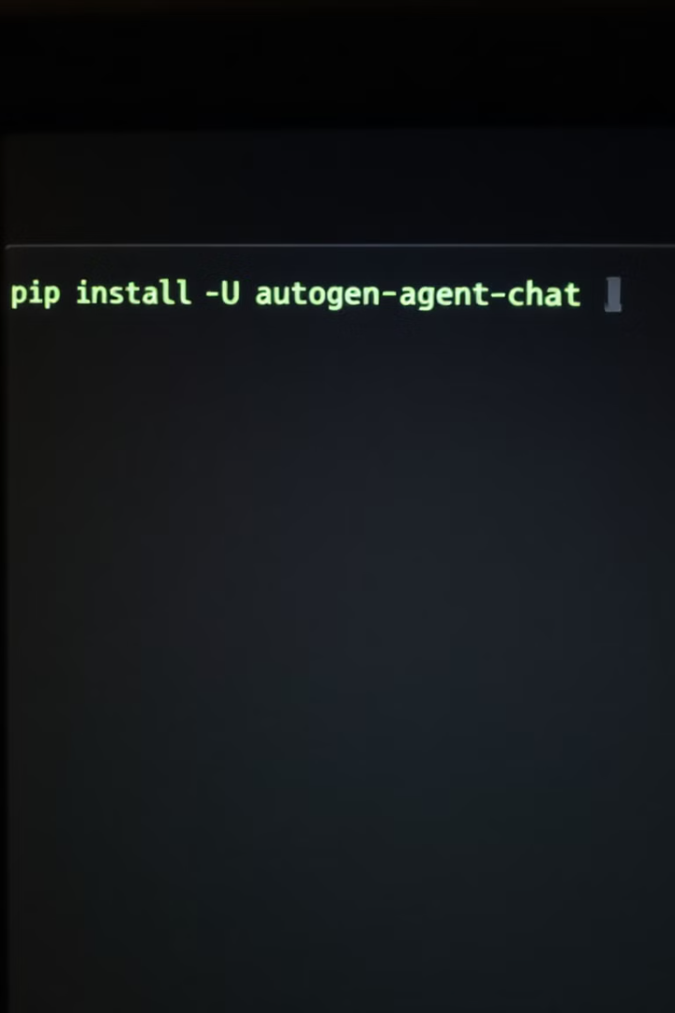
Installation
# requirements: AutoGen requires Python 3.10 or later pip install -U "autogen-agentchat" "autogen-ext[openai]"
This will get you the Autogen AgentChat, a quick agent layer sitting on top of the Autogen Core.
Additional dependencies may be required based on the agents you create, but this will get you started.

Slide 9

Competing Frameworks
1
LangChain
Excels at chaining LLM outputs and prompt engineering
Integrates a wide range of LLMs but focuses less on explicit multi-agent orchestration
LangChain
2
CrewAI
Specializes in task delegation and agent coordination within teams.
CrewAI
3
Semantic Kernel
Microsoft’s framework focused on semantic functions and AI orchestration. This is a C# framework that will soon be adopting autogen's AgentChat and multi-agent chat features. Microsoft considers this their prod ready agentic solution, but its a lot more rigid than autogen.
microsoft/semantic-kernel: Integrate cutting-edge LLM technology quickly and easily into your apps
Various options exist. Each has strengths and weaknesses. Consider project needs when choosing.

Slide 10
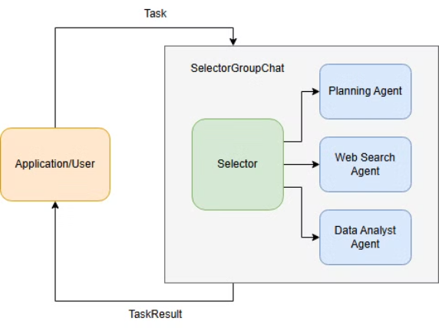
Multi-Agent System Patterns:
Selector Group Chat (group-chat pattern)
Selector Group Chat
SelectorGroupChat is a group chat with a model-based next speaker selection mechanism. When the team receives a task, the following steps are executed:
The team analyzes the current conversation context to determine the next speaker using a LLM model.
The team prompts the selected speaker agent to provide a response, which is then broadcasted to all other participants.
The termination condition is checked to determine if the conversation should end, if not, the process repeats from step 1.
When the conversation ends, the team returns the TaskResult containing the conversation history from this task.
Notes:
Introducing SelectorGroupChat
Okay, let’s dive into SelectorGroupChat! Picture this as a team setup where everyone’s taking turns sharing messages with the whole group. What’s special here is that a generative model—think of something like a large language model—steps in to decide who speaks next. It’s not just random or fixed; it’s based on what’s already been said, so the conversation flows dynamically and stays relevant. It’s all about creating that context-aware teamwork vibe!
Highlighting Key Features
So, what’s SelectorGroupChat bringing to the table? First off, it’s got this model-based speaker selection, where the next person to talk is picked by analyzing the conversation. You can also set up roles and descriptions for each participant—like who they are and what they’re good at—so the model’s got a clear picture to work with. By default, it avoids letting the same person speak twice in a row, but you can flip that switch if you want with allow_repeated_speaker=True. Plus, you can tweak the prompts that guide the selection or even swap in your own custom function to take full control of who’s up next.
Customization Note
Here’s a quick heads-up: SelectorGroupChat is a high-level API, which makes it super easy to get started. But if you’re someone who loves to dig into the details and customize everything, you can check out the Group Chat Pattern in the Core API docs. That’ll let you build your own group chat logic from the ground up if you need more flexibility.
How It Works
Now, let’s break down how SelectorGroupChat actually runs. It’s a bit like RoundRobinGroupChat, where everyone gets a turn, but instead of a set order, it uses a model to pick the next speaker. Here’s how it goes: When you give the team a task—say, through run() or run_stream()—it looks at the conversation history and the participants’ details, like their names and roles. The model then decides who’s best to speak next. Usually, it won’t pick the same speaker back-to-back unless there’s no one else, though you can override that rule. And if you don’t like the model’s choice, you can plug in your own selection function instead.
Step-by-Step Process
Once the next speaker’s chosen, the team prompts that agent to respond, and their message gets shared with everyone. After that, it checks if the conversation’s done—based on some termination condition. If not, it loops back to pick the next speaker, and we keep going. When it’s all wrapped up, you get a TaskResult with the full conversation history from that task. Simple, but powerful!
Conversation Continuity
One cool thing to note: after the task ends, the conversation context doesn’t just disappear. It sticks around in the team and all the participants. So, if you start a new task, it’ll build on what came before. Want a clean slate instead? Just call reset(), and you’re back to square one.
Example Use Case
To tie this all together, we’re going to look at a quick example. We’ll use SelectorGroupChat for a web search and data analysis task. It’s a straightforward way to see how this setup works in action, and I think you’ll get a good feel for its potential.

Slide 11
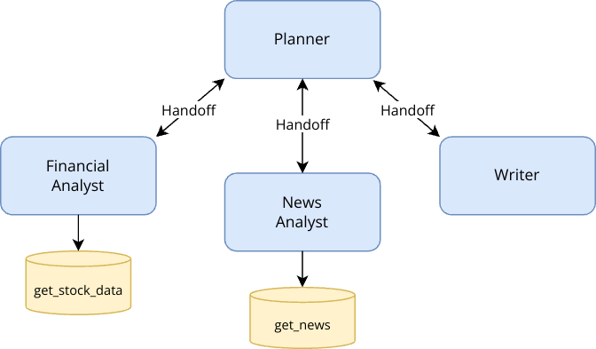
Agent Patterns-Swarm Group Chat (handoff pattern)
Swarm implements a team in which agents can hand off task to other agents based on their capabilities. It is a multi-agent design pattern first introduced by OpenAI in Swarm. The key idea is to let agent delegate tasks to other agents using a special tool call, while all agents share the same message context. This enables agents to make local decisions about task planning, rather than relying on a central orchestrator such as in SelectorGroupChat.
This system is designed to perform stock research tasks by leveraging four agents:
Planner: The central coordinator that delegates specific tasks to specialized agents based on their expertise. The planner ensures that each agent is utilized efficiently and oversees the overall workflow.
Financial Analyst: A specialized agent responsible for analyzing financial metrics and stock data using tools such as get_stock_data.
News Analyst: An agent focused on gathering and summarizing recent news articles relevant to the stock, using tools such as get_news.
Writer: An agent tasked with compiling the findings from the stock and news analysis into a cohesive final report.
Notes:
Introduction to Swarm
Alright, let's dive into Swarm! It’s a really interesting concept from OpenAI—a multi-agent design pattern where you’ve got a team of agents working together. The cool part? These agents can pass tasks to each other based on what they’re good at. It’s all wrapped up in a high-level API, which makes it pretty straightforward to set up these collaborative interactions.
Key Concept
The big idea with Swarm is delegation. Picture this: agents can hand off tasks to one another using a special tool call. What’s neat is that every agent shares the same message context—they’re all in sync throughout the process. This setup lets each agent decide locally who should take on a task next, rather than relying on some central boss like you’d see in a setup like SelectorGroupChat.
Customization Note
Swarm’s designed to be easy to use with its high-level API, which is great for getting started. But if you’re someone who likes to tinker and needs more control—like customizing things beyond what Swarm offers out of the box—you can check out the Handoff Pattern in the Core API documentation. That lets you build your own version of Swarm tailored to your needs.
How Swarm Operates
So, how does Swarm actually work? Think of it like a group chat where agents take turns chiming in. It’s got some similarities to setups like SelectorGroupChat or RoundRobinGroupChat, where all the agents broadcast their responses and stay on the same page with a shared message context. The twist with Swarm is how it picks the next speaker—it’s all based on the latest HandoffMessage in the conversation. Each agent can throw out a HandoffMessage to say, ‘Hey, you take it from here!’ For example, if you’re using an AssistantAgent, you can set the handoffs argument to list out which agents it can pass tasks to. And if you want to get creative, you can use Handoff to tweak the message content or change how those handoffs happen.
Process Overview
Here’s how the whole thing flows: Every agent can generate a HandoffMessage to suggest who’s up next. When the team kicks off a task, the first agent jumps in, works on it, and decides right then and there if it’s time to pass it off—and to whom. If it sends a HandoffMessage, the next agent picks up the ball, with the full conversation history in hand. This back-and-forth keeps going until the task’s done or we hit some kind of stopping point.

Slide 12
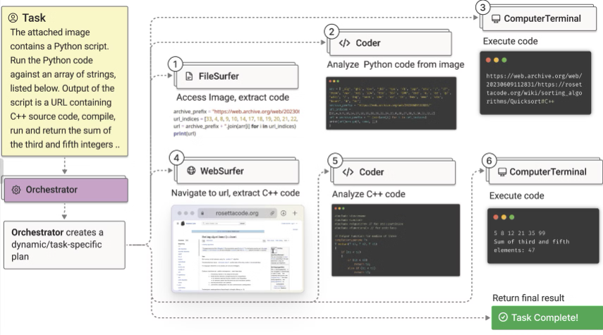
Agent-Patterns-Magentic-One
Built on top of autogen, Magentic-One is a high-performing generalist agentic system designed to solve such tasks. Magentic-One employs a multi-agent architecture where a lead agent, the Orchestrator, directs four other agents to solve tasks. The Orchestrator plans, tracks progress, and re-plans to recover from errors, while directing specialized agents to perform tasks like operating a web browser, navigating local files, or writing and executing Python code.
Notes:
Opening Hook
Picture this: a team of AI agents collaborating like a well-oiled machine, tackling everything from web browsing to file management to coding—all without breaking a sweat. That’s Magentic-One in a nutshell! It’s a generalist multi-agent system built to handle open-ended tasks across all sorts of domains, and it’s a pretty big deal in the world of AI. When it dropped in November 2024, it was turning heads by hitting competitive scores on a bunch of agentic benchmarks. If you’re into the numbers, there’s a technical report with all the juicy details—definitely worth a look.
What Magentic-One Is and Why It Matters
So, what makes Magentic-One special? It’s like a digital Swiss Army knife—it’s versatile, powerful, and designed to step up where single-agent systems might struggle. Whether you need it to dig through files, surf the web, or whip up some code, it’s got you covered. This isn’t just a small tweak to existing tech—it’s a significant leap forward for multi-agent systems, and the benchmarks back that up.
Evolution and Implementation
Let’s talk about how it’s built. When Magentic-One first launched, it was running on the autogen-core library—solid, but a bit rigid. Since then, we’ve moved it over to autogen-agentchat, and that’s a game-changer. It’s now more modular and way easier to use, so you can slot it into your own projects without a headache. The orchestrator—called MagenticOneGroupChat—is now just an AgentChat team, which means it plays nice with all the standard AgentChat agents and features. Plus, the specialized agents—like MultimodalWebSurfer for web tasks, FileSurfer for file handling, and MagenticOneCoderAgent for coding—are now available as standalone AgentChat agents. You can mix and match them in any AgentChat workflow, not just Magentic-One. And if you want the full experience with zero fuss, there’s a helper class called MagenticOne that ties it all together, just like in the original paper.
Extra Resources
Want to dive deeper? We’ve got a blog post and that technical report I mentioned earlier. They’re packed with insights on how Magentic-One works and what it can do—perfect for anyone who loves the behind-the-scenes stuff.
Caution: Using It Responsibly
Alright, a quick heads-up before we wrap up. Magentic-One is powerful, but it’s interacting with a digital world built for humans, so there are some risks to watch out for. Think of it like handing a power tool to a skilled worker—you wouldn’t let them use it without safety gear. Here’s how to keep it safe:
Use Containers: Run everything in Docker containers to box the agents in and protect your system.
Virtual Environment: Keep them in a sandbox so they can’t poke around in sensitive areas.
Monitor Logs: Check what they’re up to during and after tasks—catch any odd moves early.
Human Oversight: Have a human nearby to supervise, especially for big tasks. No fully unsupervised adventures!
Limit Access: Don’t give them free rein on the internet or other resources unless they need it.
Safeguard Data: Lock away sensitive info—they don’t need to see your secrets.
Oh, and heads-up: agents might try funny stuff sometimes, like clicking ‘accept’ on cookie pop-ups or even asking humans for help. Plus, there’s a chance of prompt injection attacks from webpages sneaking in tricky instructions. So, always run it in a controlled setup and keep an eye on things.

Slide 13
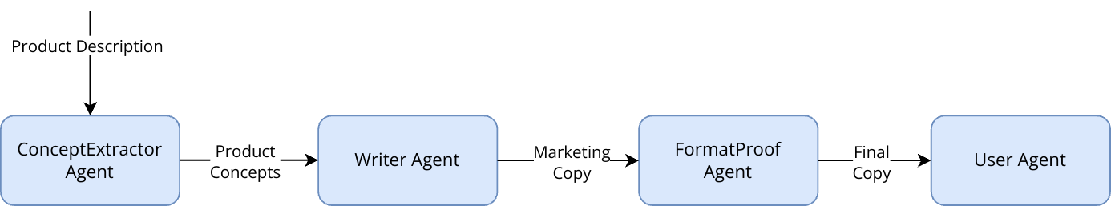
Agent Patterns-Sequential Workflow
Sequential Workflow is a multi-agent design pattern where agents respond in a deterministic sequence. Each agent in the workflow performs a specific task by processing a message, generating a response, and then passing it to the next agent. This pattern is useful for creating deterministic workflows where each agent contributes to a pre-specified sub-task.
Notes:
Sequential Workflow is a multi-agent pattern where agents tackle tasks in a fixed order, like a production line. Each agent handles a specific job, processes input, and passes it to the next, ensuring a predictable outcome.
Today’s example: transforming a product description into polished marketing copy using four agents.
The Pipeline
Concept Extractor Agent: Starts by analyzing the product description. It pulls out key features, target audience, and unique selling points, delivering a clear, structured summary.
Writer Agent: Takes that summary and turns it into engaging marketing copy with a strong narrative.
Format & Proof Agent: Refines the draft—fixes grammar, boosts clarity, and keeps the tone consistent for a pro finish.
User Agent: Hands the final copy to the user, wrapping up the process.
How it flows: Each agent’s output feeds the next. It’s a clean, step-by-step handoff that builds to the goal.
Why It’s Useful
Perfect for tasks needing structure and specialization.
Deterministic—same inputs, same results.
Easy to follow and manage.
Visual cue: Picture a relay race—each agent runs their leg and passes the baton, or check the slide’s flowchart if it’s there.
Quick note: It’s flexible enough to adapt to different inputs, and you can add monitoring to catch issues.
Takeaway: Use this pattern for clear, multi-step processes where every stage matters. Think about applying it to your own projects!

Slide 14
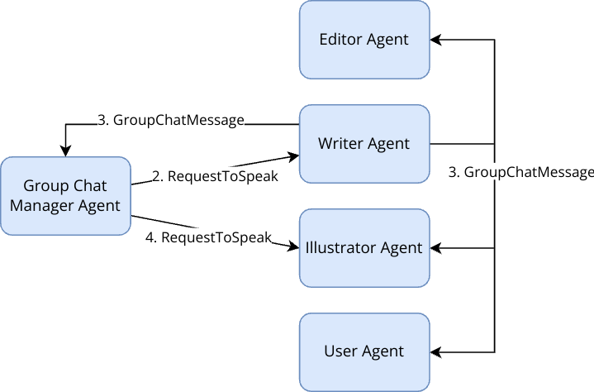
Agent Patterns-Group Chat
Group chat is a design pattern where a group of agents share a common thread of messages: they all subscribe and publish to the same topic. Each participant agent is specialized for a particular task, such as writer, illustrator, and editor in a collaborative writing task. You can also include an agent to represent a human user to help guide the agents when needed.
In a group chat, participants take turn to publish a message, and the process is sequential – only one agent is working at a time. Under the hood, the order of turns is maintained by a Group Chat Manager agent, which selects the next agent to speak upon receiving a message. The exact algorithm for selecting the next agent can vary based on your application requirements. Typically, a round-robin algorithm or a selector with an LLM model is used.
Notes:
What it is:
Group chat is a design pattern where a team of specialized agents—like a writer, illustrator, or editor—collaborate by sharing a single thread of messages. They all subscribe and publish to the same topic, working together on tasks like a children’s storybook. You can even add a human agent to steer the group when needed.
How it works:
Agents take turns posting messages in a sequential flow—only one speaks at a time. A Group Chat Manager controls the order, picking the next speaker after each message. It might use a simple round-robin approach or a smarter AI model (like an LLM) to decide who’s next, depending on your needs.
Why it’s great:
It splits tricky tasks into bite-sized pieces, letting each agent focus on their strength. Plus, you can nest group chats into bigger hierarchies for more complex projects.
Key takeaway: Group chat is like a digital assembly line for creative or complex tasks—each agent brings their A-game, one step at a time.

Slide 15
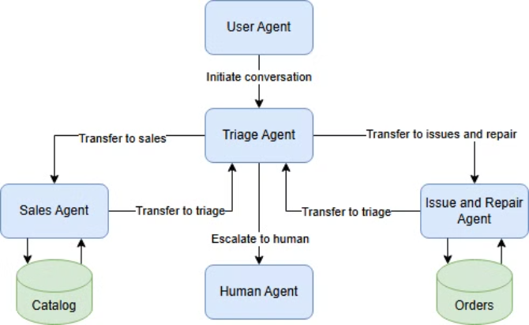
Agent Patterns-Handoff
Handoff is a multi-agent design pattern introduced by OpenAI in an experimental project called Swarm. The key idea is to let agent delegate tasks to other agents using a special tool call.
We can use the AutoGen Core API to implement the handoff pattern using event-driven agents. Using AutoGen (v0.4+) provides the following advantages over the OpenAI implementation and the previous version (v0.2):
It can scale to distributed environment by using distributed agent runtime.
It affords the flexibility of bringing your own agent implementation.
The natively async API makes it easy to integrate with UI and other systems.
Notes:
What is Handoff? Handoff is a multi-agent design pattern pioneered by OpenAI in their experimental Swarm project. It’s like a relay race: agents pass tasks to one another using a special tool call, delegating work to the best-suited teammate.
Why Use It? This pattern shines in dynamic, collaborative scenarios. It allows agents to hand off tasks based on expertise, boosting efficiency and flexibility when a single agent can’t handle everything.
AutoGen’s Take (v0.4+) With AutoGen’s Core API, we’ve implemented handoff using event-driven agents. This approach offers some key advantages over OpenAI’s version and AutoGen’s earlier release (v0.2):
Scalability: It leverages a distributed agent runtime, making it ideal for large, distributed environments.
Customization: You can bring your own custom-built agents to the table.
Integration: The natively async API simplifies connections with UIs and external systems.
Big Picture Handoff is all about teamwork: agents passing the baton seamlessly to keep the workflow humming toward success.

Slide 16
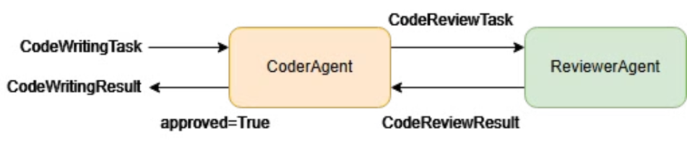
Agent Patterns - Reflection
Reflection is a design pattern where an LLM generation is followed by a reflection, which in itself is another LLM generation conditioned on the output of the first one. For example, given a task to write code, the first LLM can generate a code snippet, and the second LLM can generate a critique of the code snippet.
In the context of AutoGen and agents, reflection can be implemented as a pair of agents, where the first agent generates a message and the second agent generates a response to the message. The two agents continue to interact until they reach a stopping condition, such as a maximum number of iterations or an approval from the second agent.
Notes:
Reflection Reflection is a design pattern where an LLM generation is followed by a reflection, which in itself is another LLM generation conditioned on the output of the first one. For example, given a task to write code, the first LLM can generate a code snippet, and the second LLM can generate a critique of the code snippet. In the context of AutoGen and agents, reflection can be implemented as a pair of agents, where the first agent generates a message and the second agent generates a response to the message. The two agents continue to interact until they reach a stopping condition, such as a maximum number of iterations or an approval from the second agent. Let’s implement a simple reflection design pattern using AutoGen agents. There will be two agents: a coder agent and a reviewer agent, the coder agent will generate a code snippet, and the reviewer agent will generate a critique of the code snippet.

Slide 17
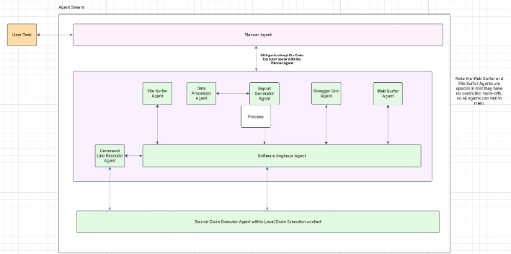
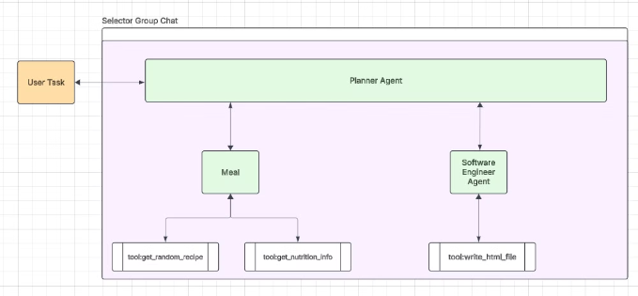
Final Thoughts
Keep it simple. I had originally designed the demo today with a larger number of agents, with each one refined on a more specific task. I wanted abstraction and beauty. Each agent its own tiny atomic creature. While I was able to achieve success with the below model and it could handle quite a bit more generic requests, it took twice as long, triple the tokens and was much more undeterministic. This might have been due to multiplied hallucinations going through too many models and having the whole system have to cycle through many more times to fix errors detecting in each previous step. If you want a larger multi-agenic system, keep in mind you will need heavy control over data quality, ACL and the like.
Before (slow, heavy token count, overly generalized)
After (faster, less tokens, more deterministic, much less failure rate)
Notes:
Think of the telephone game kids play where one person whispers something in another person’s ear, and each person whispers what they heard to the next person. After 20 people down the line, the message they repeat is typically much different than the original message going through the system. This is somewhat how it felt with too many agents in the local chat.

Slide 18

Demo and Q&A
Links Mentioned
Code example repo: https://github.com/pmajor74/demo.autogen_meal_blogwriter
Autogen Docs: https://microsoft.github.io/autogen/stable
AutoGen Studio: https://github.com/microsoft/autogen/blob/main/python/packages/autogen-studio
“Multi-Agent Systems with AutoGen”, by Victor Dibia: https://www.manning.com/books/multi-agent-systems-with-autogen
Autogen 0.4 framework: https://microsoft.github.io/autogen/stable
Similar Frameworks
LangChain: https://www.langchain.com
CrewAI: https://www.crewai.com
Semantic Kernel: https://github.com/microsoft/semantic-kernel

